Slide 1



River Road
Route Alternatives Study
October 20-21, 2022

Slide 2
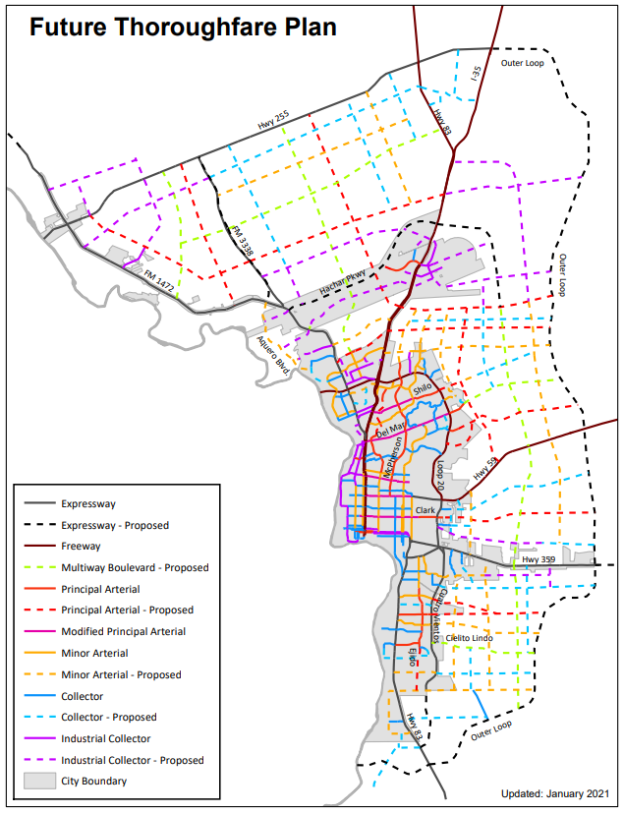
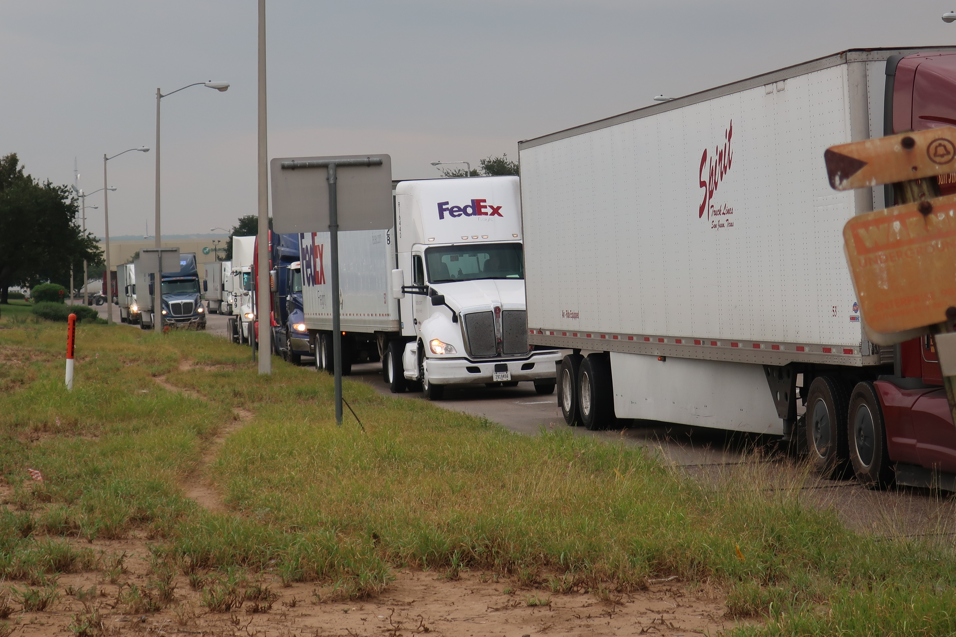
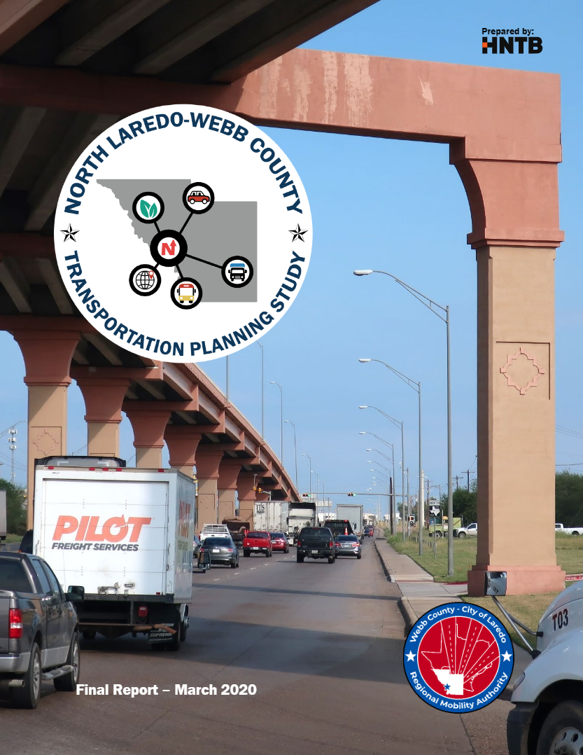
What is this Project For?
FM 1472 carries 60,000 vehicles daily, more than Interstate 35!
Laredo Trade is growing fast!
Largest inland port in the US
37% of all US-Mexico trade comes through Laredo
World Trade Bridge which handles 90% of cross-border freight in Laredo.
FM 1472 is the only major arterial connecting the World Trade Bridge to adjacent industrial areas.
Following Through
Development of River Road was included in both the 2021 Future Thoroughfare Plan and the 2020 North Laredo-Webb County Transportation Study
A new roadway is needed to accommodate growth and safely acilitate movement of people and goods.
Pictured Above: Heavy freight traffic on Mines Rd / FM 1472.
60% of those vehicles are freight trucks, higher than any other roadway in Texas.

Slide 3
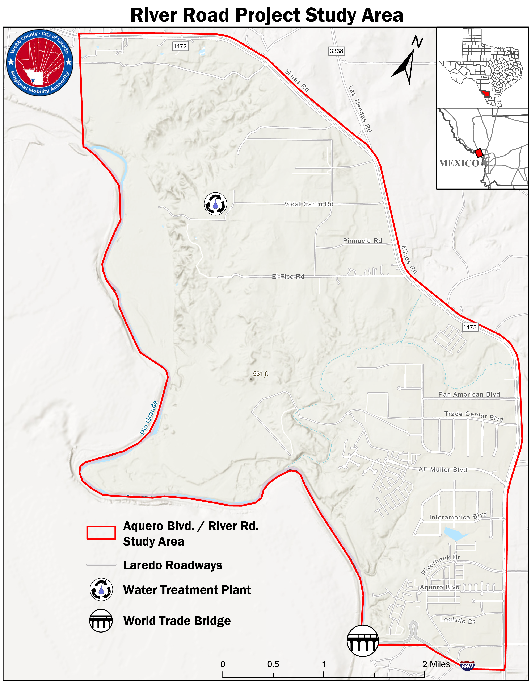
Project Purpose & Need
The River Road Project aims to serve the residents of Laredo and Webb County:
Prioritize roadway safety
Offer congestion relief
Increase travel time reliability
Provide alternative route choices
Facilitate future economic growth

Slide 4
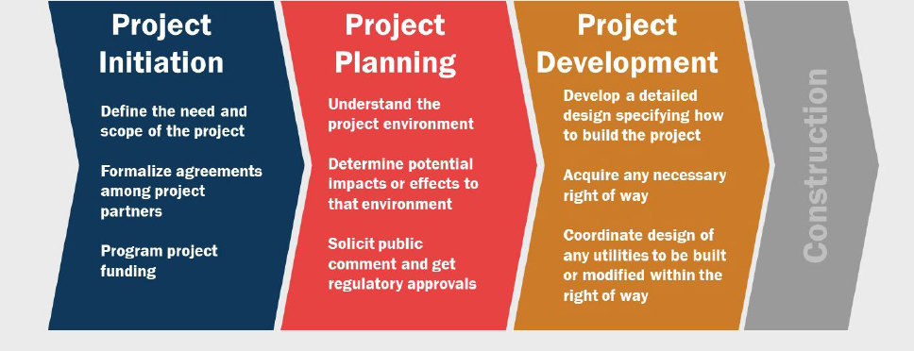
How does the Planning Process Work?
The Laredo-Webb County Project Delivery Process
The River Road Route Alternatives Study fall under the Project Initiation stage depicted in the figure on the right
Within the Project Initiation stage are multiple steps and tasks outlined on the next slide
This project has yet to identify design or construction funding

Slide 5
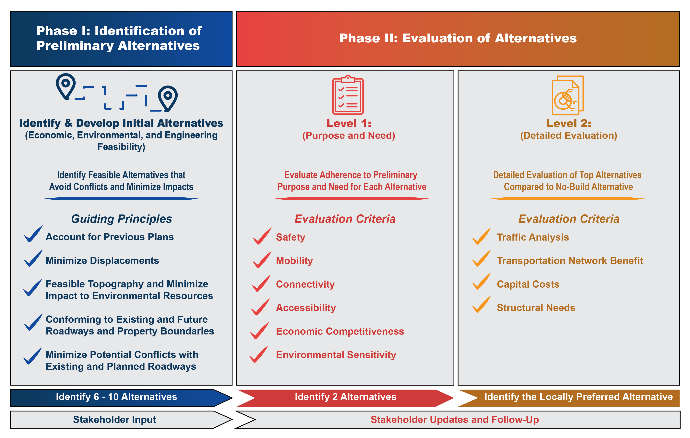
What does a “Route Alternative Study” Involve?
We
Are
Here

Slide 6
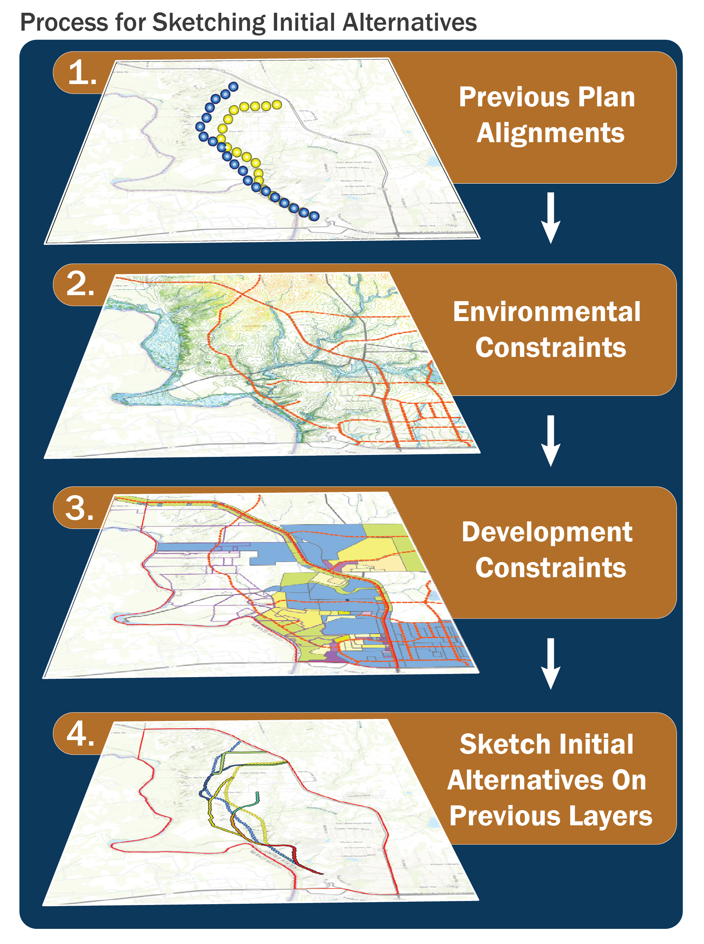
Mapping Initial Alternatives
Identified Environmental Constraints:
Topography (Sombrerito Creek)
Wetlands
Floodplains
Identified Development Constraints
Ongoing Light Industrial and Commercial Development on Peak, Vidal Cantu, El Pico Roads
El Pico Water Treatment Plant
E/W Pipeline
Finalizing Alternatives
‘Initial Alternatives’ are our first, best attempt to provide options that navigate these constraints
‘Initial Alternatives’ are neither final nor unchangeable

Slide 7
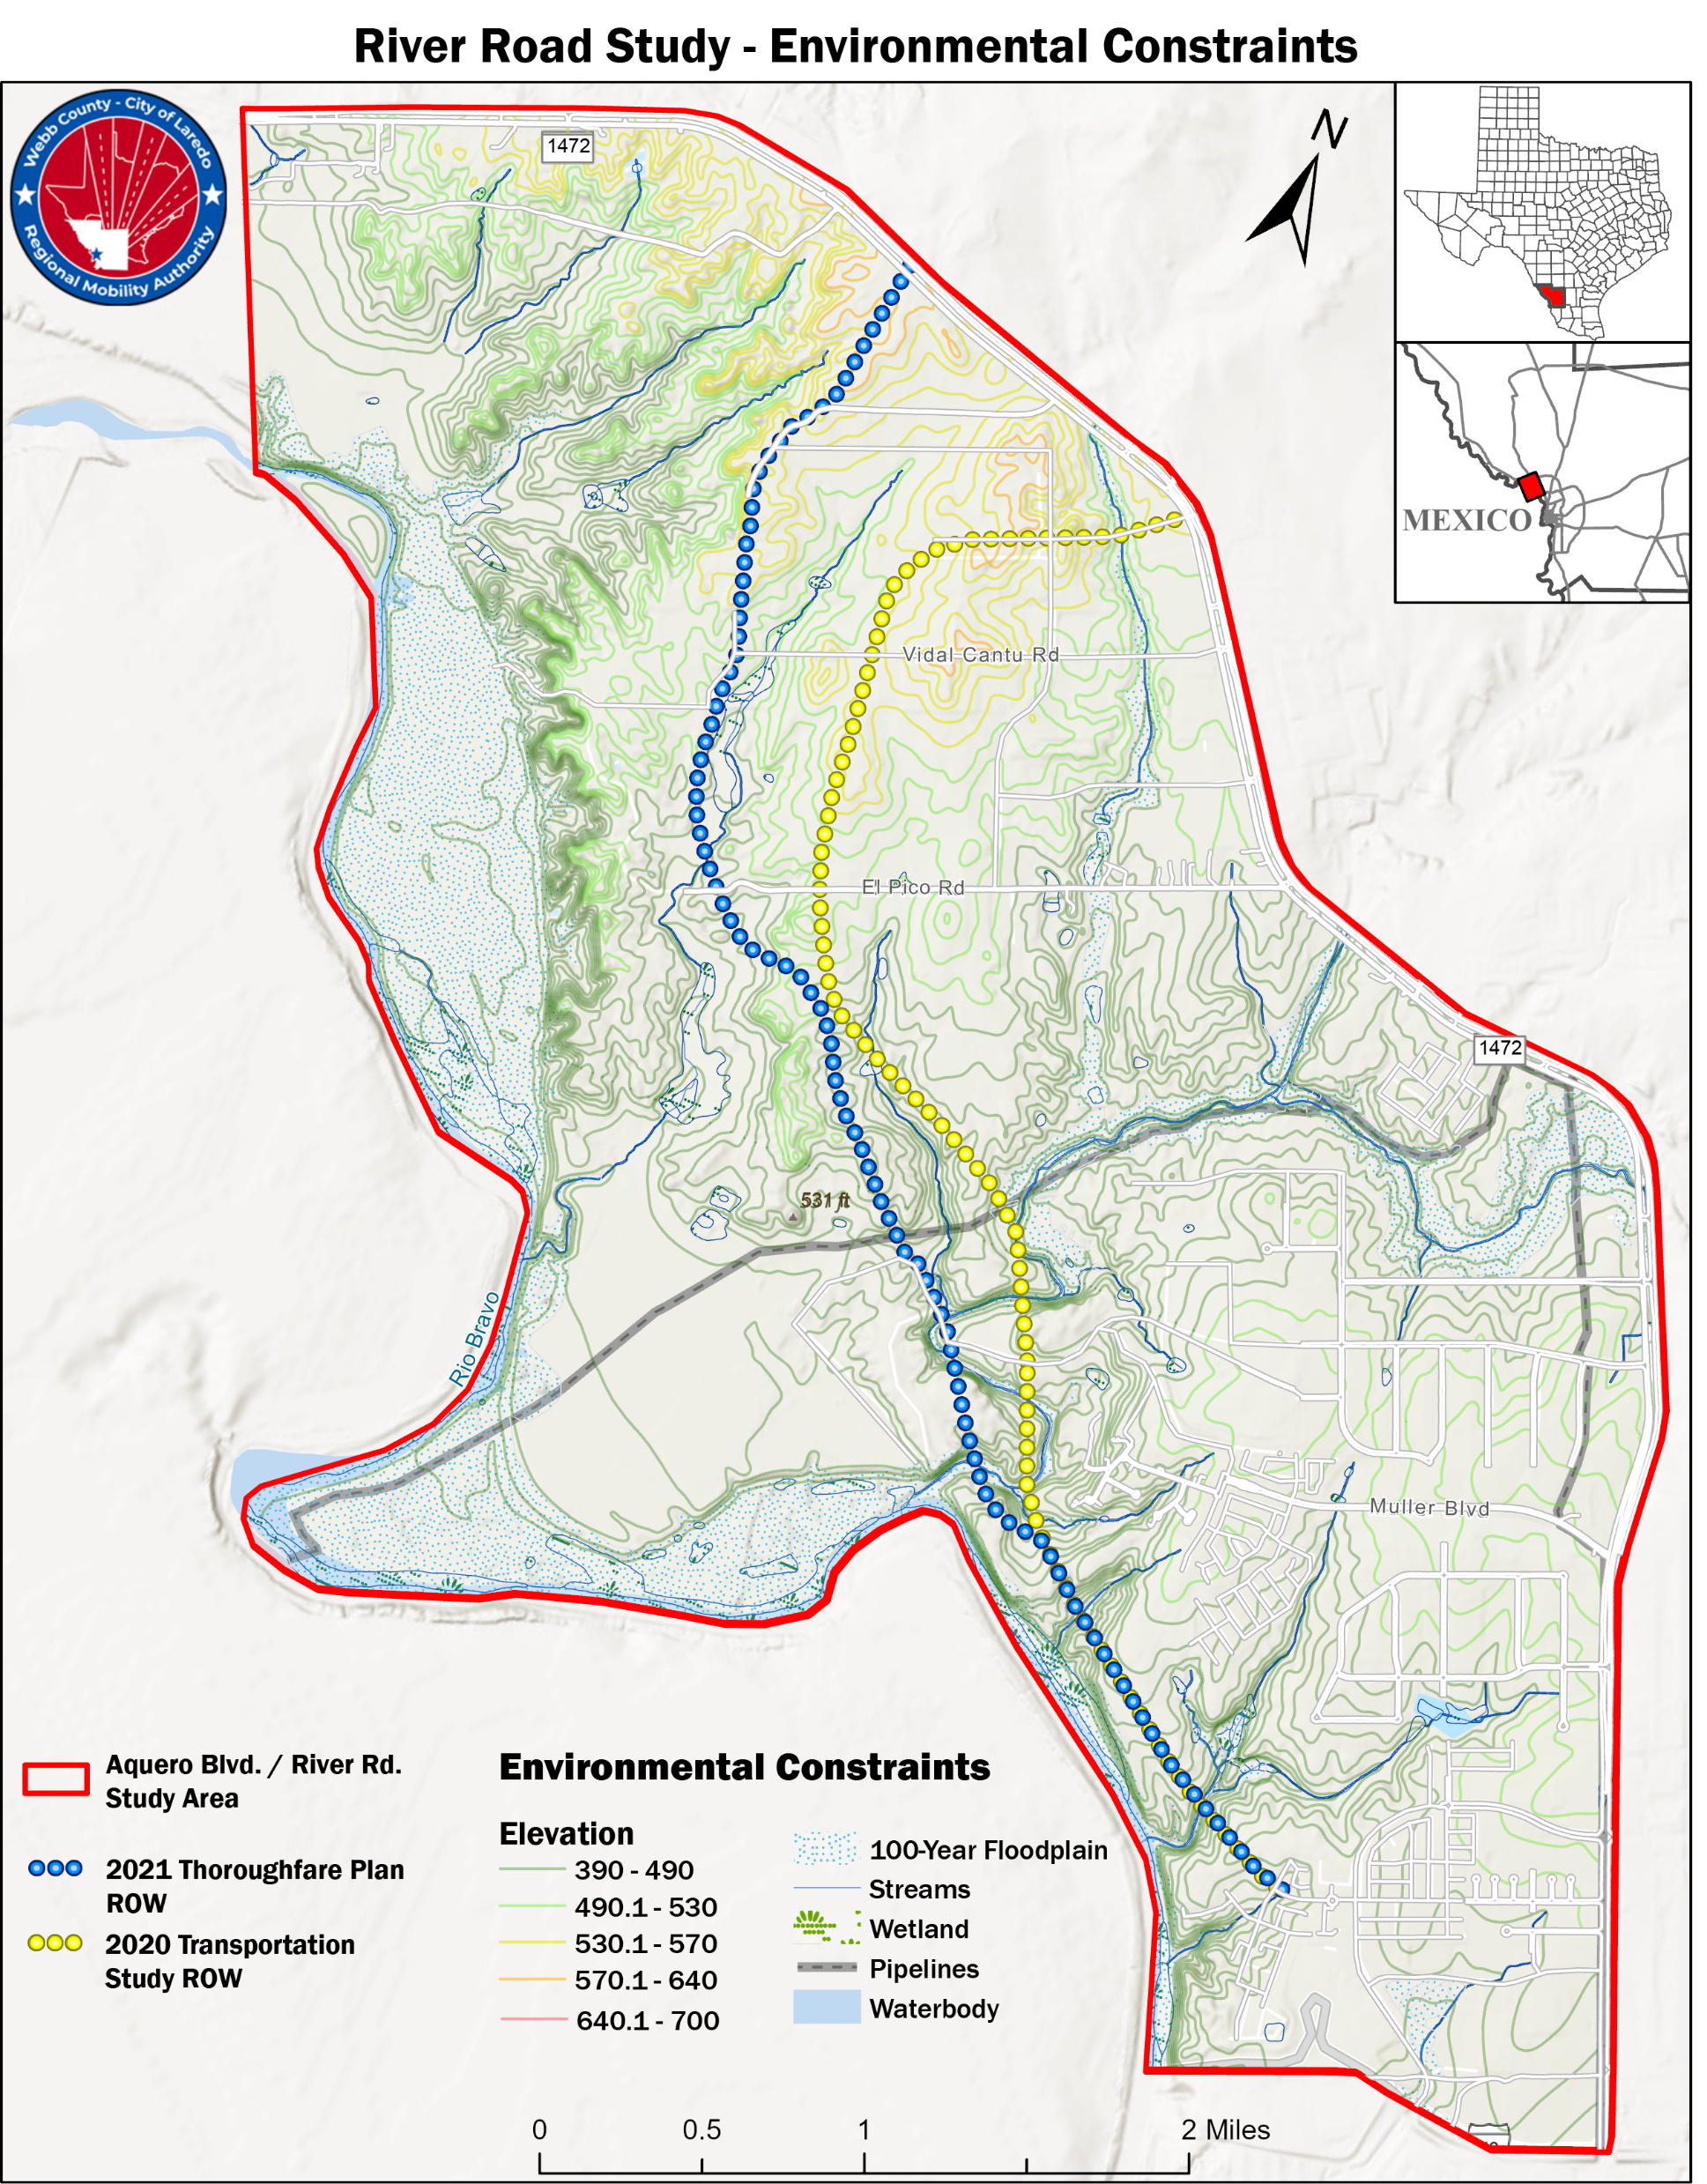
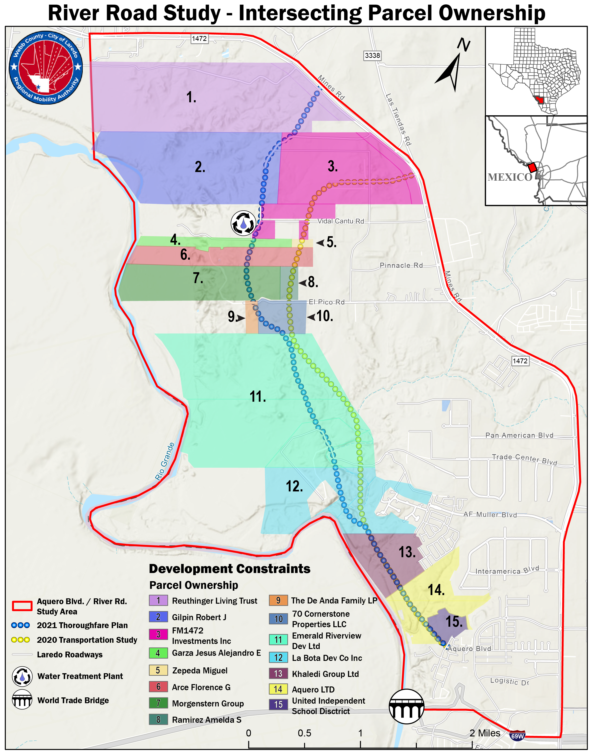
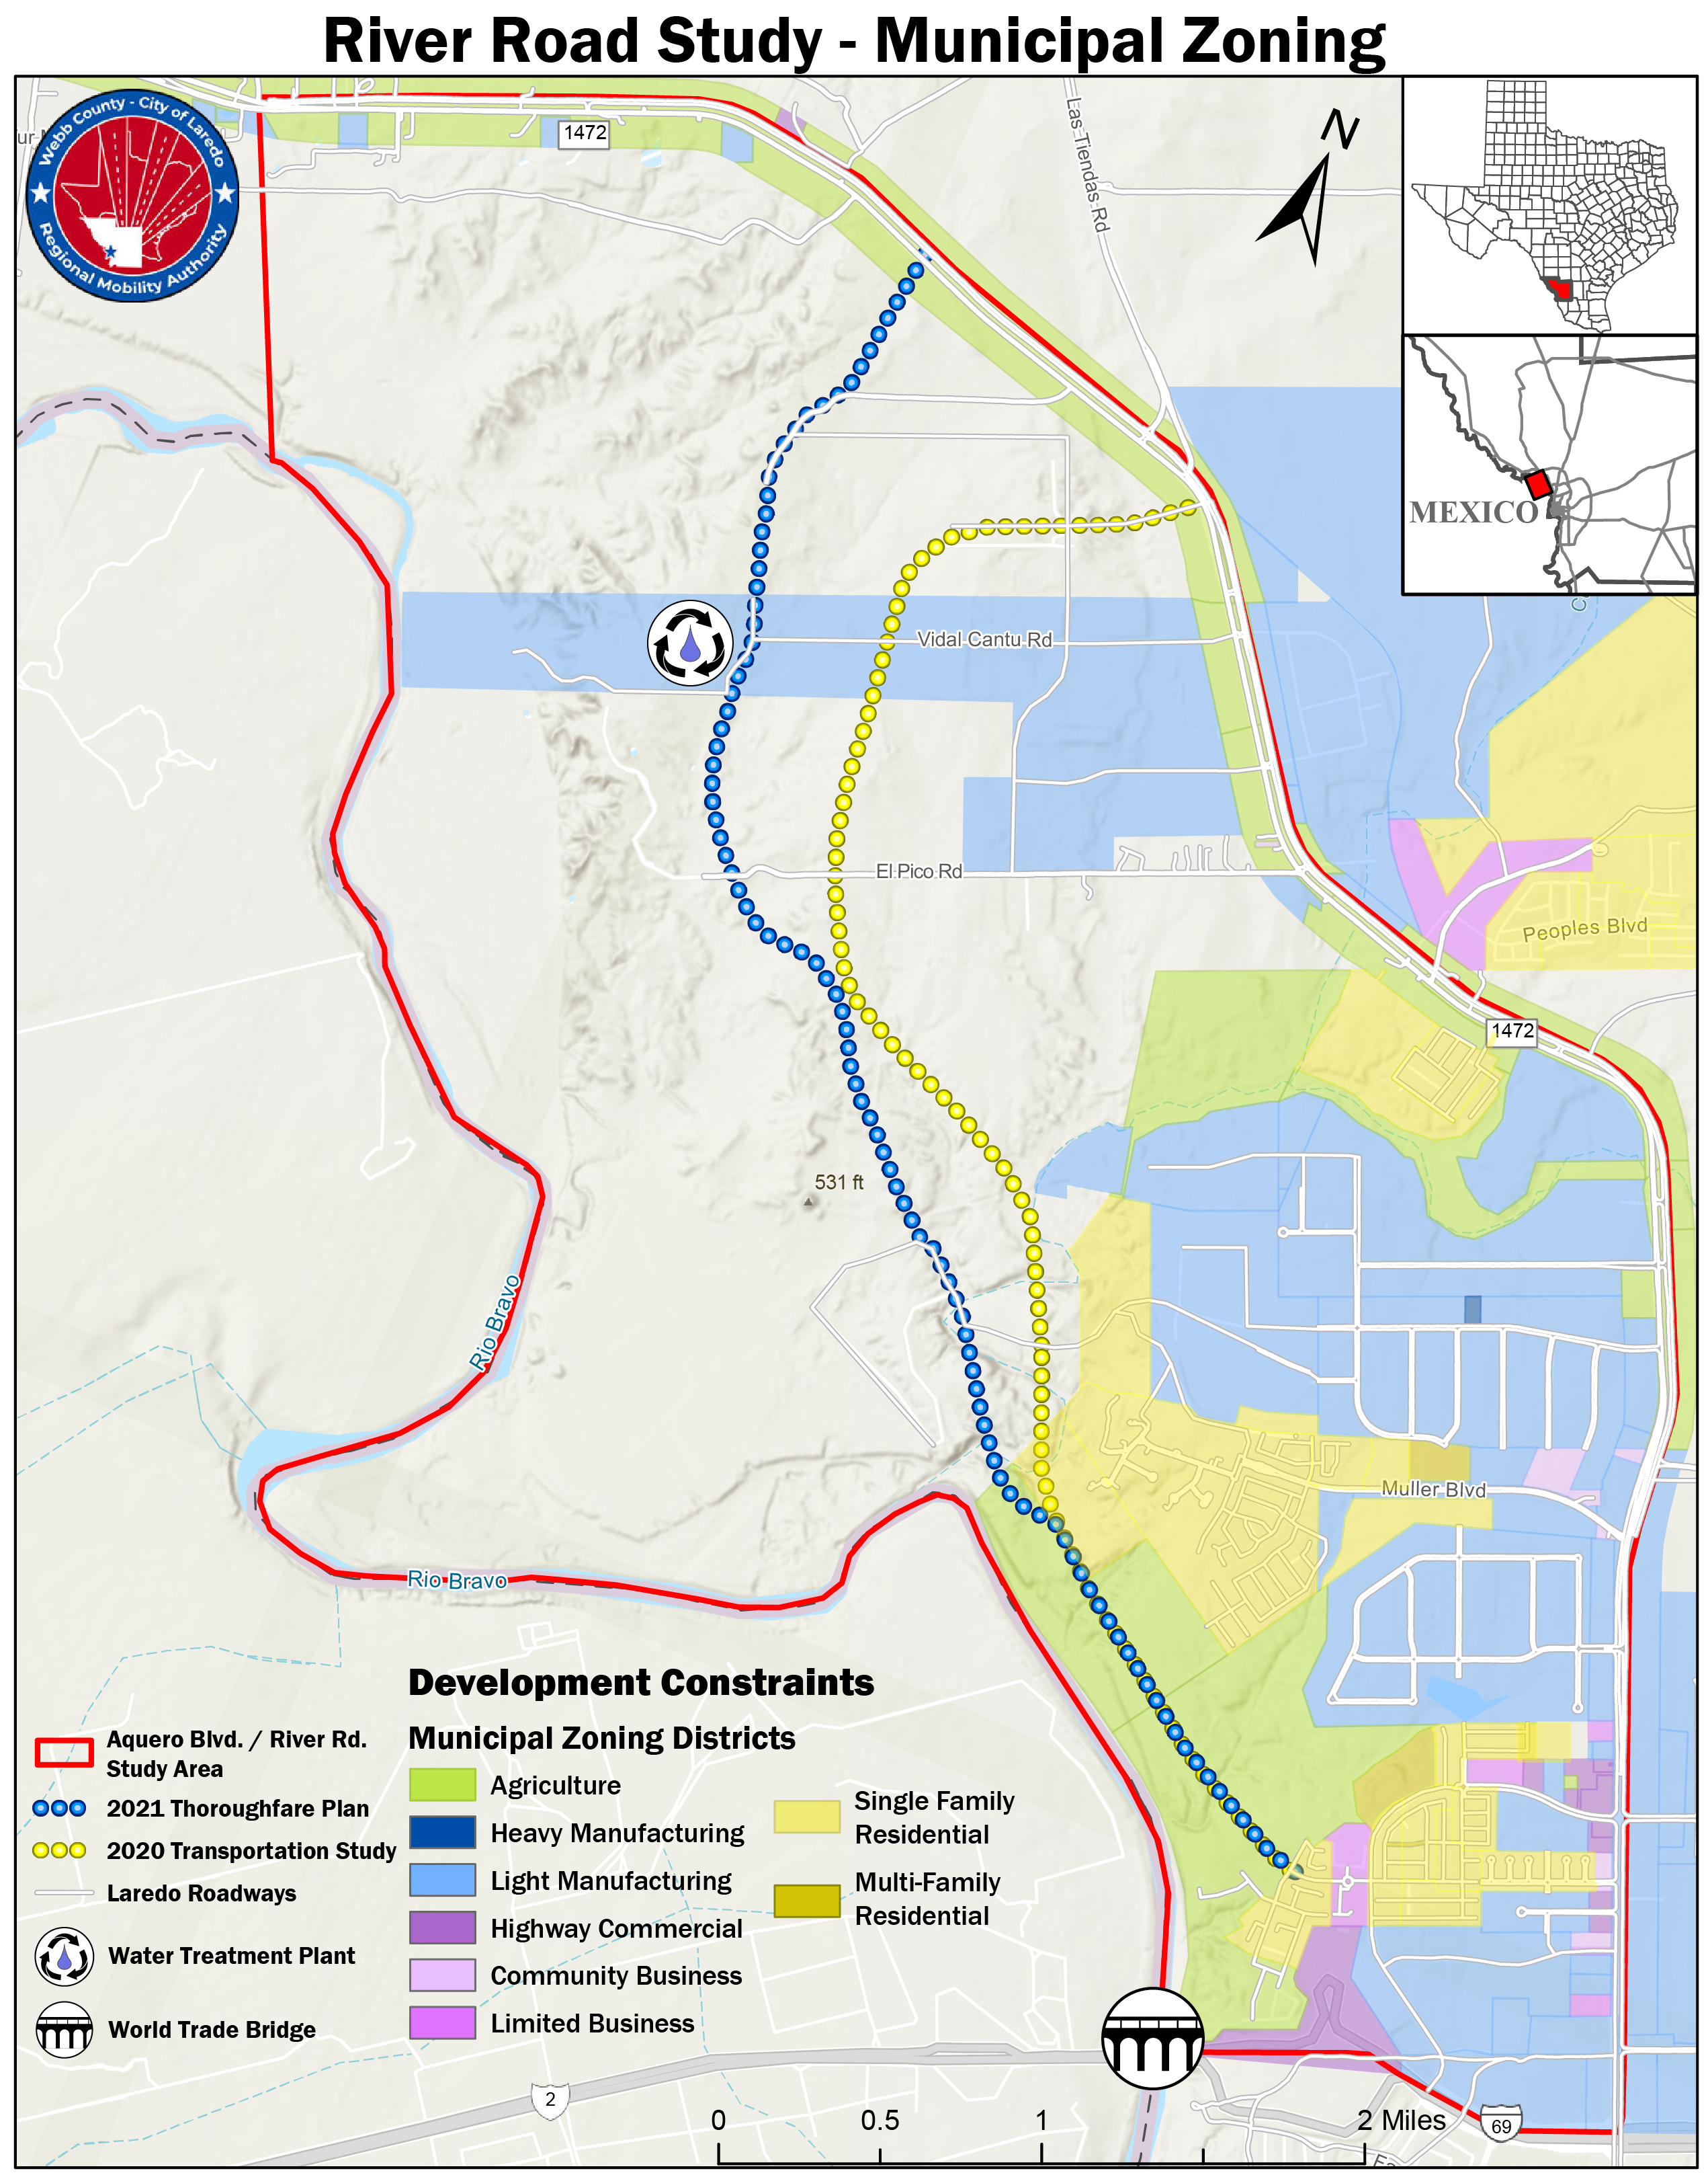
Mapping Initial Alternatives

Slide 8
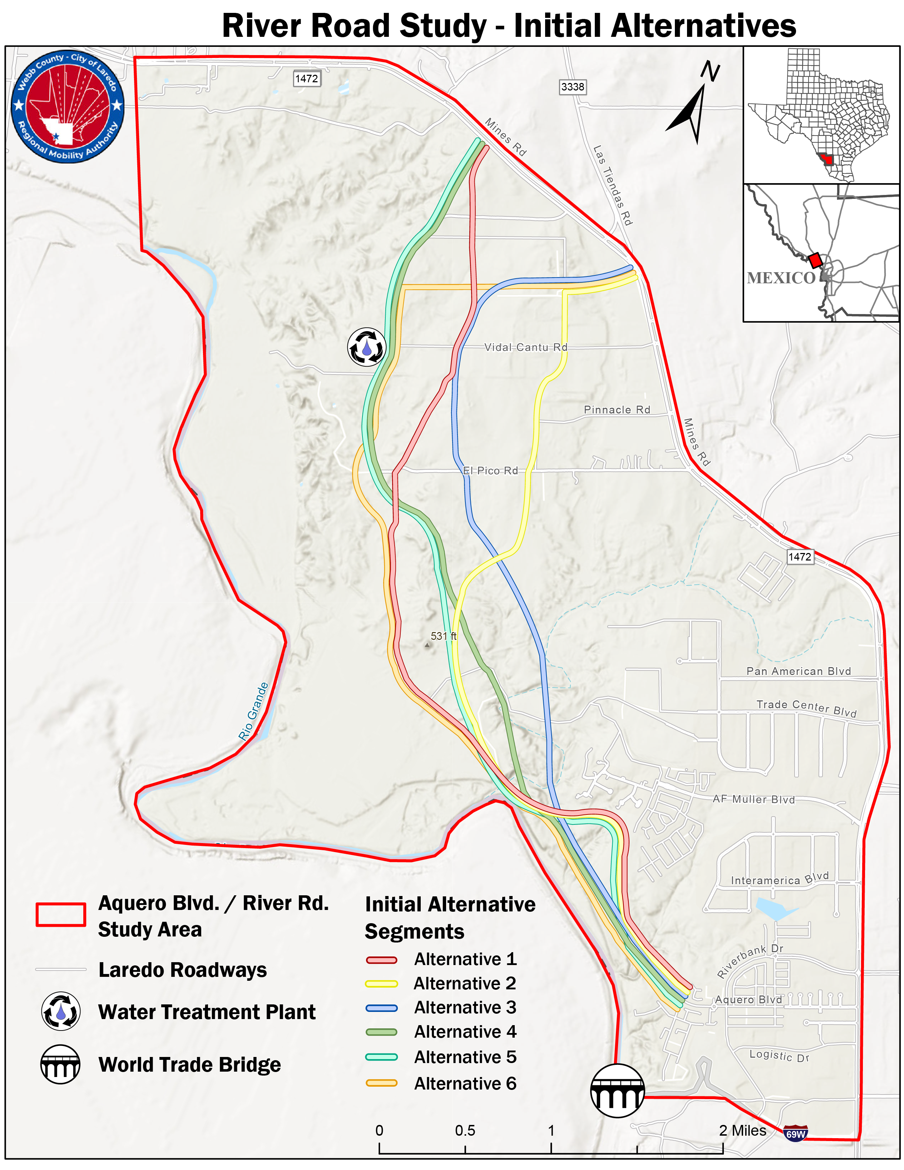
What We Need From You
Utilize the Large Table Maps to View the Initial Alternatives
What did we miss?
Recent development
Opportunities to utilize existing roads ROW
Which alternatives offer fairest tradeoffs?
Are there adjustments that can be made?
Remember the Guiding Principles
Account for Previous Plans
Minimize Displacements
Utilize Feasible Topography and Minimize Environmental Impact
Where possible conform to existing roadways and property boundaries

Slide 9
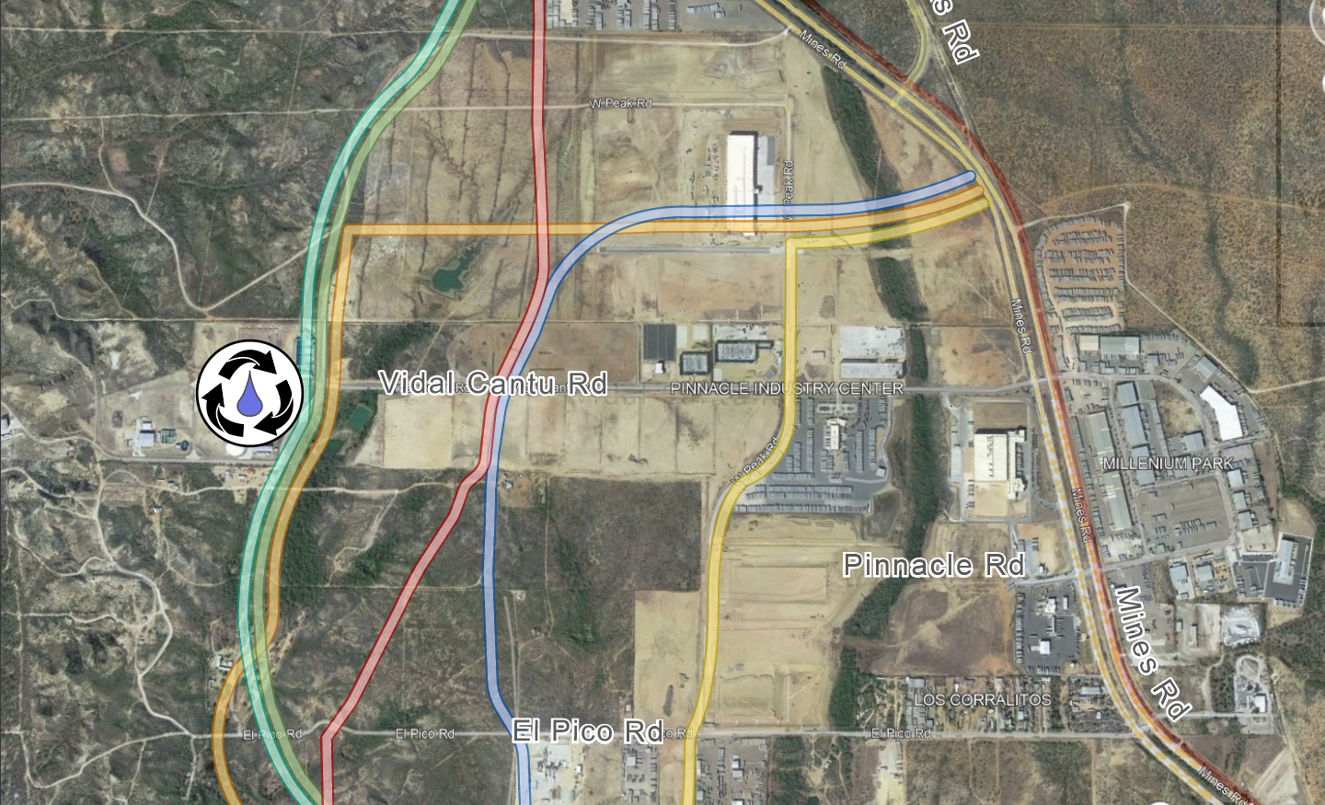
Examples of Tradeoffs and Constraints
Development along El Pico and Vidal Cantu Roads
Available aerial imagery is outdated
Property lines run E/W, and do not align with one another

Slide 10
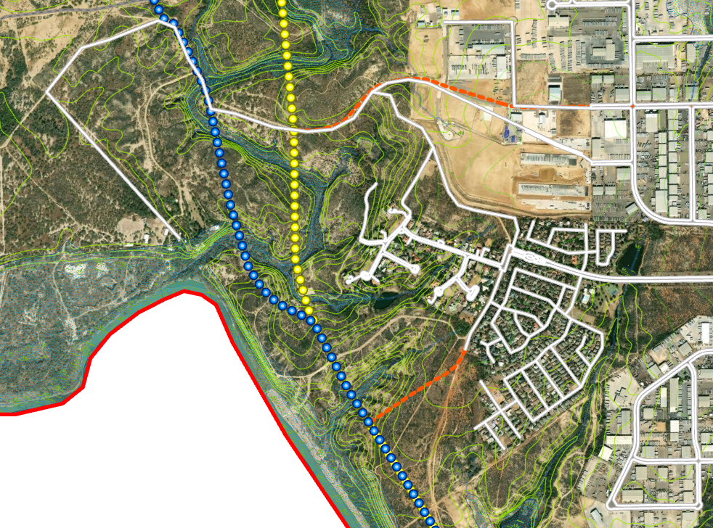
Examples of Tradeoffs and Constraints
Topography along El Sombrerito Creek complicates previous plan alignments (2020 Laredo Transportation Study & 2021 Thoroughfare Plan)
Minimizing bridges minimizes costs

Slide 11
Next Steps
1. Incorporate Today’s Feedback
2. Identify and Evaluate 2 Alternatives
Must follow Phase I’s guiding principles, then:
Evaluate against Phase II criteria
3. Continue to share project updates and gather feedback from community stakeholders
4. Identify one locally preferred alternative
Thank You for Your Participation!
Email us at: River_Road_Study@hntb.mail.onmicrosoft.com

Slide 12
Project Schedule
Project Timeline | 2023 |  | 2023
Summer 2022-Summer 2023 | Q3 | Q4 | Q1 | Q2
Develop Preliminary Purpose & Need
Identify Physical and Environmental Constraints
Develop Initial Route Alternatives
Level 1 Evaluation of Initial Alternatives (6-10)
Level 2 Evaluation of Final Alternatives (2)
Prepare Locally Preferred Alternative Report
Project Partners and Funding will need to be identified, then Project Planning and Development can commence.
Stakeholder Listening Sessions

